Slide 1

ADP EndSem PrOJECT
Online Gym Management System using springboot
Supervised By: Miss. Ruby
Group No : 3
Department of Computer Science and Engineering
Faculty of Engineering & Technology (ITER)
Siksha ‘O’ Anusandhan (Deemed to be) University
Bhubaneswar, Odisha
Saugat Mohanty- 2141013224
Ronik Kumar Das- 2141004063
Swoyam Prakash Mohanty- 2141013226
Ankit Mishra- 2141013145
1

Slide 2
Introduction
Overview
The project, "Online Gym Management System using Spring Boot," is designed to streamline gym operations by offering a comprehensive platform for managing memberships and schedules. , the system provides an easy-to-use interface for gym administrators to manage members, classes, and schedules. This application streamlines administrative tasks, improves communication between staff and members, and ensures a smooth operation of the gym’s day-to-day activities.
2

Slide 3
Introduction contd..
Motivations
In today's fast-paced world, manual gym management can lead to inefficiencies and errors. This motivated the development of the "Online Gym Management System using Spring Boot," aimed at automating memberships, payments, and scheduling. The project addresses limitations of traditional methods while meeting the demand for digital solutions to improve efficiency. Additionally, it offers hands-on experience with modern frameworks like Spring Boot and Java Full Stack, bridging theoretical knowledge with real-world application.

Slide 4
Introduction contd..
Uniqueness of work
This project stands out for its comprehensive approach to gym management using the Spring Boot framework, enabling scalability, faster deployment, and streamlined development. By integrating an interactive frontend (CSS, JavaScript, JSP) with a secure backend (Java, MySQL), it ensures a smooth user experience. Features like real-time customizable membership plans and intuitive workout scheduling make it unique. Its adaptability for small and medium-sized gyms, along with its user-centric design and potential for future enhancements, distinguishes it in the fitness technology domain.

Slide 5
Literature Survey
Existing System
Gym management is often handled manually using registers or spreadsheets, which are error-prone, time-consuming, and lack real-time updates, making them inefficient for growing operations. Some digital solutions address these issues by offering features like member management, payment tracking, and scheduling. However, these systems are often expensive, require complex setups, and lack flexibility, making them unsuitable for smaller gyms with specific needs. As a result, many small and medium-sized gyms struggle to find cost-effective, user-friendly, and customizable solutions that align with their unique operational requirements.
5

Slide 6
Literature Survey Contd..
Problem Identification
Existing systems face several challenges: Manual Processes: - Prone to errors in record-keeping and calculations. - Time-consuming and inefficient for growing gyms. - Lack of centralized data management.
Limitations of Existing Software: - High subscription costs, unaffordable for small gyms. - Limited customization for individual gym needs. - Complex interfaces requiring extensive staff training.
Scalability Issues: - Manual systems cannot scale with gym growth. - Existing software struggles to adapt to evolving requirements. The "Online Gym Management System using Spring Boot" overcomes these challenges with an affordable, scalable, and user-friendly platform tailored for small to medium-sized gyms.

Slide 7
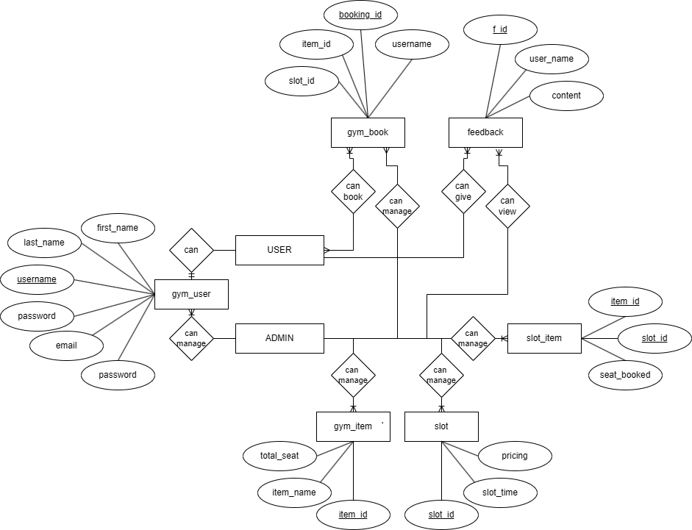
ER Diagram
7

Slide 8
Tools used
Front-end : Java Server Pages , CSS , JavaScript.
Back-end : Spring boot , Spring data JPA ,Spring MVC, Spring Security.
Database : MySQL.
IDE : Eclipse ide for enterprise java and web developers.
Web Server : Tomcat
8

Slide 9
Methods used
This explains the methodologies or approaches followed to develop the project. It outlines the processes and techniques used to achieve the project goals. What to include:
The development approach:
Agile or iterative development methodology.
Steps like requirement analysis, system design, coding, testing, and deployment.
Technologies and frameworks employed (e.g., Java Full Stack, Spring Boot).

Slide 10
Experimentation and Results
System Specifications
The Online Gym Management System has been developed to meet the following specifications:
System Type: Web-based application.
Frontend Technologies: JSP, CSS, JavaScript for a responsive and user-friendly interface.
Backend Technologies:
Framework: Spring Boot for efficient business logic implementation.
Programming Language: Java for backend development.
Database: MySQL for secure and structured data storage.
Build Tool: Maven for dependency management and project builds.
Development Environment: Eclipse IDE for writing, debugging, and testing code.
Server: Apache Tomcat for hosting and running the application.

Slide 11
Experimentation and Results Contd..
The system has been developed, tested, and validated to achieve the following outcomes:
User Management
Registration and Login: Members and gym staff can successfully register and log in to the system.
Role-based Access Control: Implemented to manage staff and member access, ensuring secure data handling.
User Dashboard: Features an intuitive and responsive UI for seamless user interaction.
Membership Plan Handling
Gym staff can create, manage, and assign membership plans to members.
Members can view available plans, make selections, and make payments online.

Slide 12
Experimentation and Results Contd..
Payment Tracking
The system tracks payments in real-time, ensuring accurate financial records.
Secure data storage in the MySQL database provides reliable access to payment information.
Workout Scheduling
Gym staff can assign workout schedules to members, which are visible on their dashboard.
Members can view their personalized workout schedules and interact with trainers through the system.
System Performance
The system has been tested for performance, handling multiple concurrent users efficiently.
Backend logic and data processing are optimized for minimal delays and optimal user experience.

Slide 13
Experimentation and Results Contd..
SpringBoot Features used
1. Spring Boot Starter Dependencies - Spring Boot Starter Web: Used for building web applications with embedded servers like Tomcat, eliminating the need for explicit server setup. - Spring Boot Starter Data JPA: Used for working with relational databases like MySQL in a simple and efficient way.
2. Embedded Server - The project utilizes Apache Tomcat as an embedded server, making it easier to run the application without deploying it externally
3. Spring MVC - Implements the Model-View-Controller (MVC) architecture for separating business logic, presentation, and data access layers.
4. Spring Data JPA - Used for database operations such as CRUD (Create, Read, Update, Delete) without writing boilerplate SQL queries. - The integration with MySQL ensures efficient data management and processing.
5. Dependency Management - Maven is used as a build tool, and Spring Boot simplifies dependency management by automatically resolving compatible versions of libraries.

Slide 14
Experimentation and Results Contd..
6. Spring Security - Adds security to the application by implementing role-based access control (e.g., for admin and users). - Handles login authentication and authorization for different users.
7. Application Configuration - Spring Boot's application.properties or application.yml file is used for centralizing and customizing configurations such as database connections, server ports, etc.
8. RESTful APIs - Spring Boot provides features for creating and managing REST APIs, allowing seamless communication between frontend and backend.
9. Exception Handling - Custom exception handling is supported using Spring Boot's @ExceptionHandler annotations.
10. Automatic Configuration - Spring Boot automatically configures components like Hibernate, JPA, and data sources, reducing the amount of manual configuration.

Slide 15
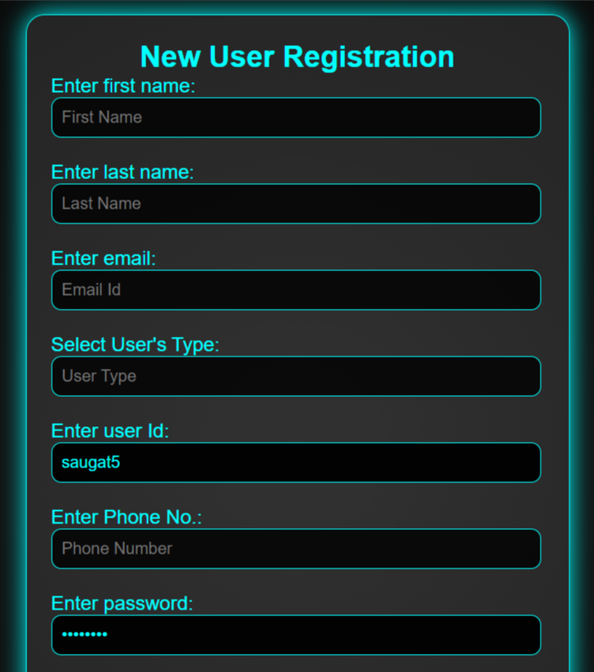
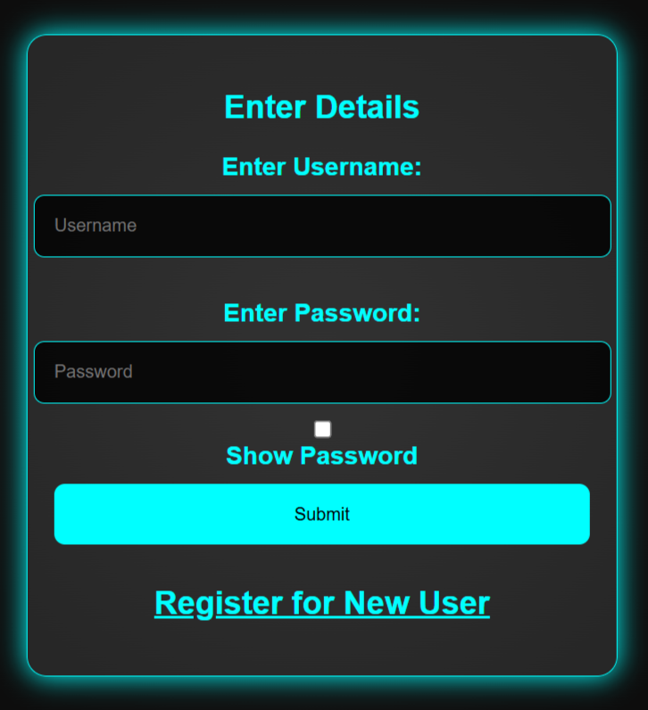
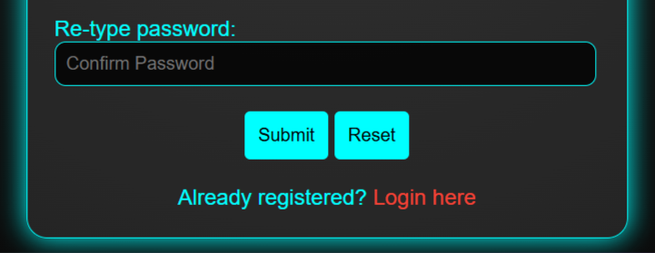
Fig:1(New user registration)
Fig:2(Login Page)

Slide 16

Fig:3(Home Page)

Slide 17
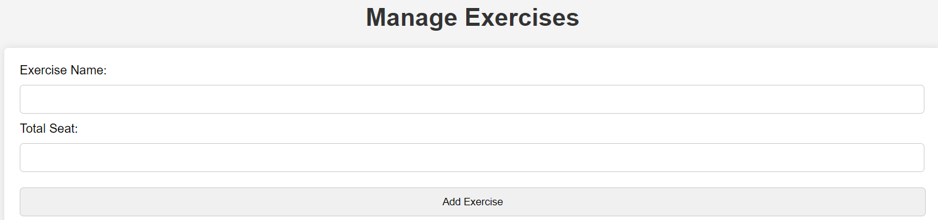
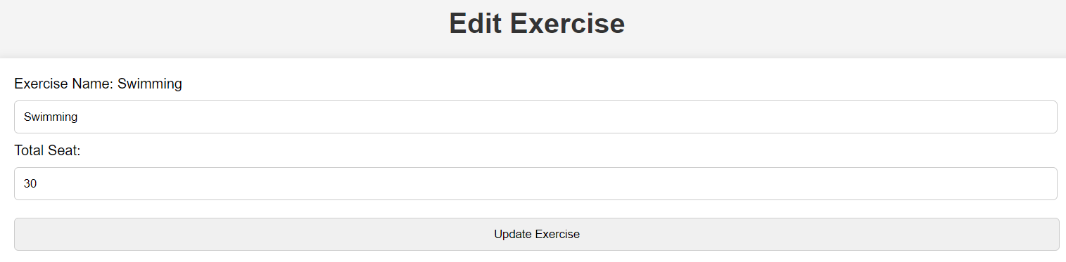
ScreenShots
Item Details
Admin can enter gym item name and Total seats.
Edit Item Details
Admin can edit gym item details
Fig:4
Fig:5

Slide 18
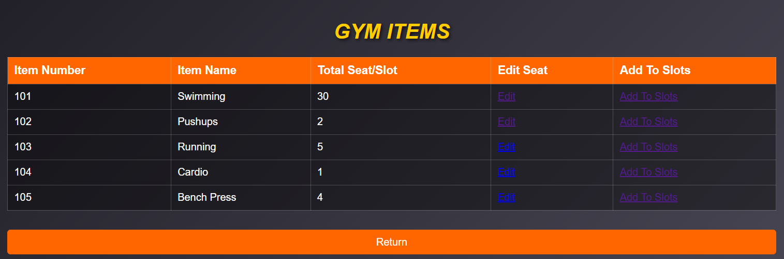
View Item Details
Admin can view item details
Fig:6

Slide 19
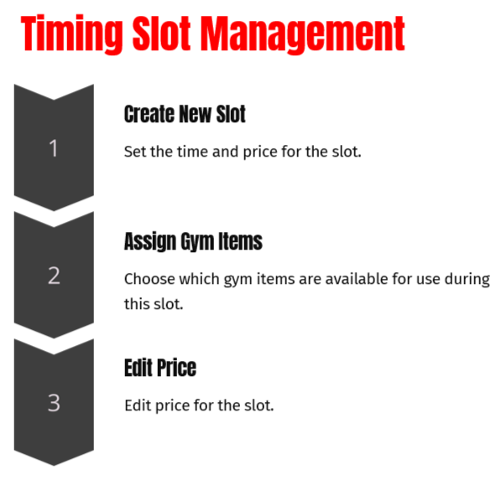
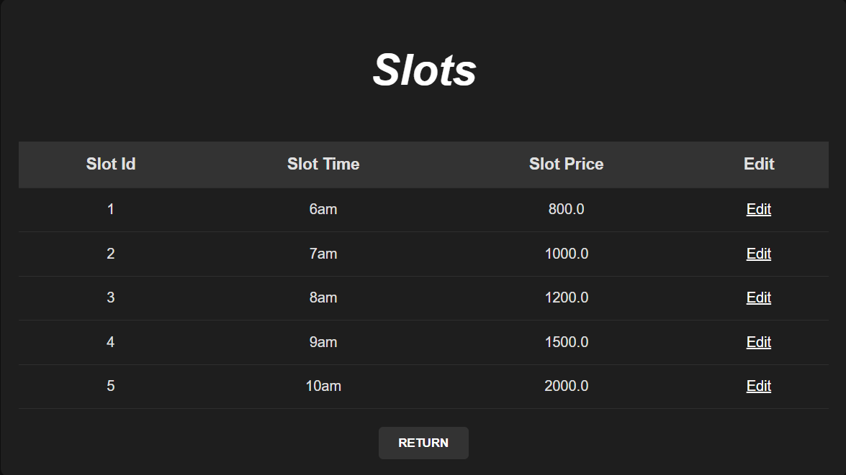
Fig:7

Slide 20
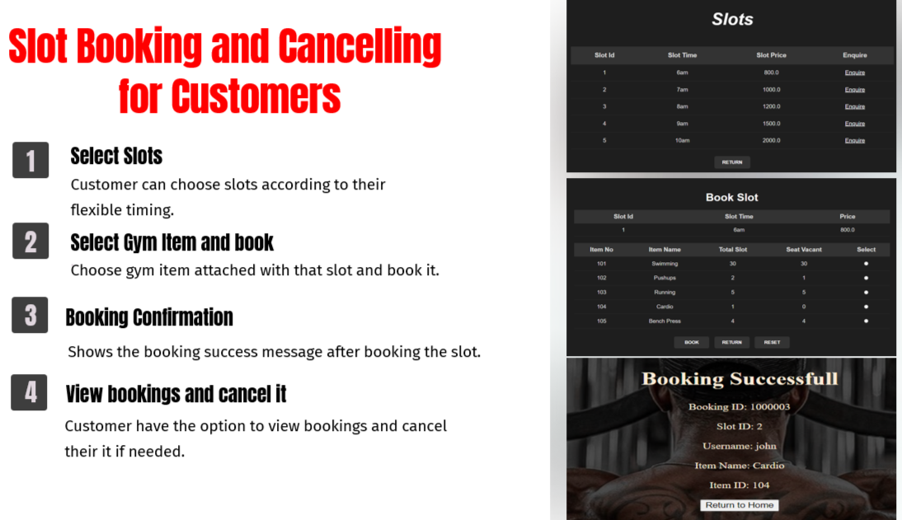
Fig:8
Fig:9
Fig:10

Slide 21
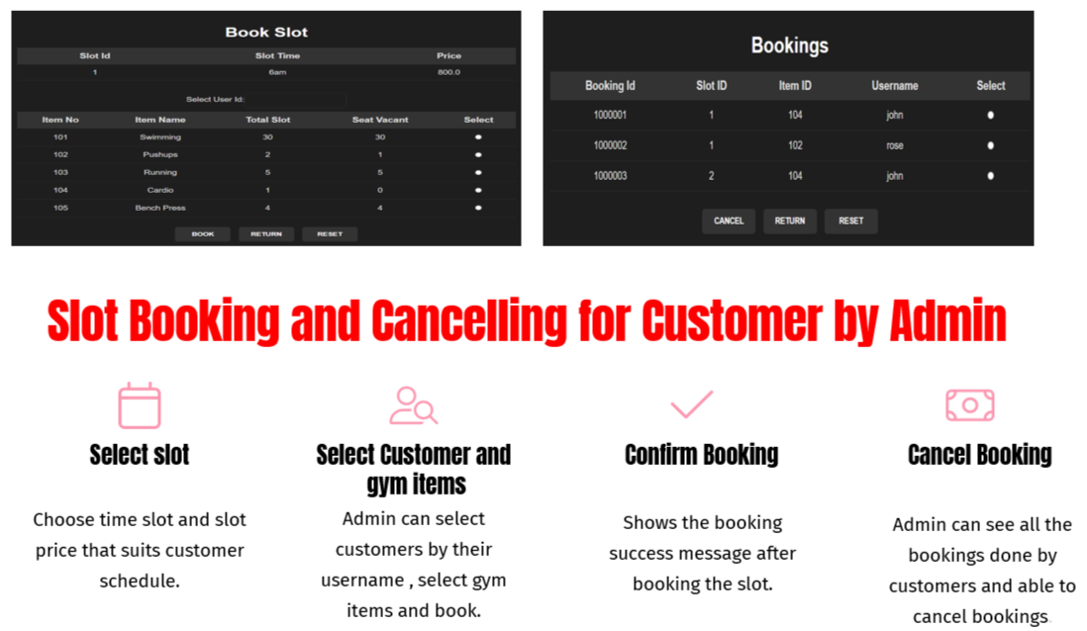
Fig:11
Fig:12

Slide 22
Conclusion and Future Scope
The Online Gym Management System offers a comprehensive platform for streamlining gym operations, providing a seamless experience for both admins and customers. Key features include gym item management, timing slot booking and feedback system.
Future Enhancement:
➢ Mobile Application Integration
➢ Advanced Analytics and Reporting
➢ AI-Powered Personalization
➢ Health and Fitness Tracking / Nutrition Tracking and Meal Planning
22

Slide 23
Bibliography
1.Spring Framework Documentation. Retrieved from: https://spring.io/projects/spring-boot
2.MySQL Documentation. Retrieved from: https://dev.mysql.com/doc/
3. JSP and Servlets. Retrieved from: https://www.oracle.com/java/technologies/java-ee-glossary.html
4. CSS: Cascading Style Sheets Retrieved from: https://www.w3.org/Style/CSS/
5. Java Programming Language. Retrieved from: https://docs.oracle.com/javase/tutorial/
6. Apache Tomcat Documentation. Retrieved from: https://tomcat.apache.org/tomcat-9.0-doc/
7. Maven Documentation. Retrieved from: https://maven.apache.org/guides/
8. Introduction to Web Development. Retrieved from: https://developer.mozilla.org/en-US/docs/Learn
9. Spring Security Documentation*. (2024). Retrieved from: https://spring.io/projects/spring-security

Slide 24

24

